Slide 1

Local Control Accountability Plan (LCAP)
Committee
Woodland Joint Unified School District
September 23, 2019

Slide 2
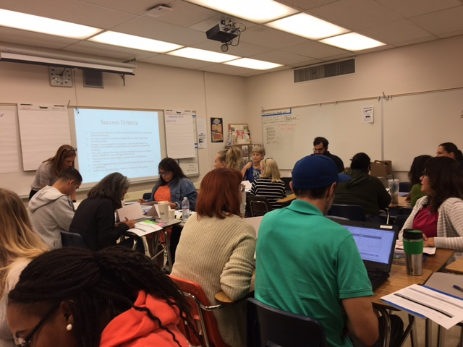

WJUSD Local Control Accountability Plan 2017-20
Year 3
Supports for Schools and Programs District Goals Equity and Access Monitoring and Accountability Professional Development School Plan for Student Achievement | Supports for Students and Families Foster and Homeless Student support 1:1 chromebooks and wireless access Counseling services Community and Family Engagement Migrant Family Support
Notes:
County Office LCAP will be essential two plans- one is for the student programs and the other is to the supports to the Districts that we serve. The input that is being collected today will help inform the SDCOE student programs.

Slide 3



Revisiting the Local Control Funding Formula (LCFF)
Greatly simplifies state funding for local educational agencies (LEAs)
ADJUSTMENTS
$
Grade Level
Per Student
Base Amount
Demographics
(Low income, English Learner, and/or Foster Youth)
11
Notes:
In California the amount of state funding that goes to support K-14 education depends on the overall size of the state budget. The formula to determine K-14 education’s share of California revenue is Proposition 98, which as a general rule of thumb results in approximately 40% of state revenues going towards K-14 education. The passage of Proposition 30 in 2012 increased state revenue, which helped increase funding for K-14
Education. Another way to think about this is that Proposition 98 determines the size of the K-14 education funding pie. Prior to the passage of the Local Control Funding Formula the state divided the pie into slices for local educational agencies—that includes districts, charter schools, and county offices of education— into two categories revenue limits and categorical programs. In effect, the state told local education agencies through the former funding formula how big their slice was and what the filling would be. Now with the Local Control Funding the state slices the pie based on a relatively simple
calculation, which funds local educational agencies the same amount per student with a handful of adjustments for grade levels and demographic characteristics such as low income students, English learners and foster youth. Also under the Local Control Funding Formula the state has largely handed over responsibility for determining the filling of each pie to local educational agencies. The expectation is that funding flexibility improves the ability of local educational agencies to meet student needs compared to the former system where the state tended to direct funding to specific activities.
The Local Control Funding Formula is a major change to how California has supported local educational agencies. Through the local control funding formula the state is providing new decision making power to local educational agencies to act based on the needs they see for students. In addition, this shifts California from treating funding as an input to support students to a resource that is linked to performance expectations.

Slide 4


Linked To
Notes:
Important Idea is that LCFF links student performance and outcomes to the money. LCAP is that document that shows that link. The Local Control Funding Formula is performance focused. A key provision of the Local Control Funding Formula is that local educational agencies must
have in place Local Control Accountability Plans that clearly show the relationship between state priorities oriented towards student outcomes and
how state funding contributed to student success. The Local Control Funding Formula is student-focused. The Local Control funding Formula places flexibility in the hand of local educational agencies with an expectation of improved outcomes for students across a variety of measures. Student need should drive funding use in a way that fits local contexts.

Slide 5
LCAP Big Ideas
LCAP is a 3-year plan, intended to be an iterative, data-driven and student-centered process
The LCAP describes the actions which lead towards the goals and the budget that is aligned to those goals
Actions must be evaluated for effectiveness especially in regards to low income, foster youth, and English Learners
LCAP development and review occurs in consultation with multiple stakeholder groups
LCAP taken for Board approval in June

Slide 6
What does it mean to be data-driven and student-centered?
Data-driven = a culture of shared accountability
  Teachers and administrators regularly review data on student progress, with a focus on student achievement using nationally normed assessments
  Outcomes are agreed upon and actions are evaluated for effectiveness at specified times
  Plans are adjusted based on results
Notes:
CDE, as part of the LCAP process, is recommending defining services within the plan – that is, organizing action steps under some larger concept that supports serving students- not about the doing it’s about the serving. This allows the District to move toward systems thinking and build stronger coherence.
For us, service connotes…. And reflects a Theory of Action.

Slide 7
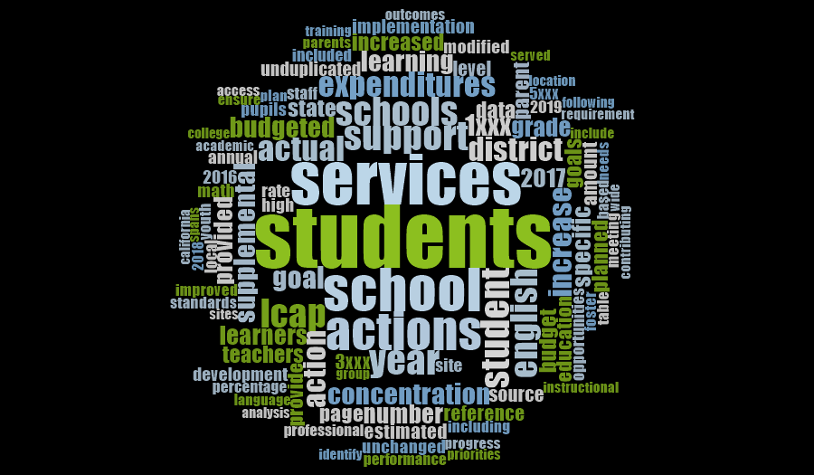
WJUSD LCAP 2017-20
Notes:
The services and the possible strategies that will go in the LCAP should be based on research.

Slide 8
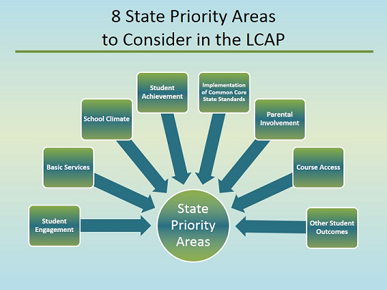
Notes:
The 8 State priority areas must be addressed in each LCAP. For County Offices there are 2 Additional Priorities: Expelled Pupils and Foster Youth
1 Basic Services
2 Implementation of State Standards
3 Parent Involvement
4 Pupil Achievement
5 Pupil Engagement
6 School Climate
7 Course Access
8 Other Pupil Outcomes
9-10 Additional Priorities for County Office of Education: Expelled Pupils & Foster Youth

Slide 9
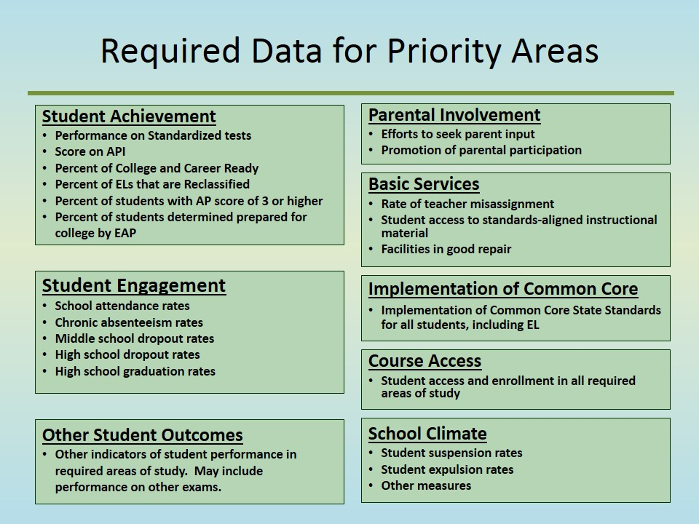
Dashboard
Notes:
The state priorities are expressed as metrics for which the district is expected to develop performance measures to demonstrate how LCFF and the LCAP support student outcomes. The date includes…

Slide 10

Process
Input is collected from staff, students, administrators, parents, and stakeholder groups through surveys and facilitated meetings
LCAP is developed and input is considered in the development of the plan

Slide 11
The Committee’s Role
Advise and contribute your knowledge and experience
Provide input and make recommendations
Represent the interests of our schools and our students
Support WJUSD in achieving the LCAP Goals

Slide 12
Who Should be on this Committee?
A representative from the School Site Council of every school site
A representative from the District English Learner Advisory Committee
Representatives from Certificated and Classified Units
Other stakeholder groups as appropriate

Slide 13
Highlights
Consistent use of common district assessments in Reading, Math, and Social-Emotional well-being
Certification opportunities for students in 9 of 11 CTE Pathways
Continuing partnerships with community organizations and agencies, including the City of Woodland and Woodland Community College
Decrease in suspensions and expulsions
Development of additional Ethnic Studies course options to support the Ethnic Studies graduation requirement
Grantwriting to establish College and Career Access Pathways 6 Year Program with WCC and Pioneer High School

Slide 14
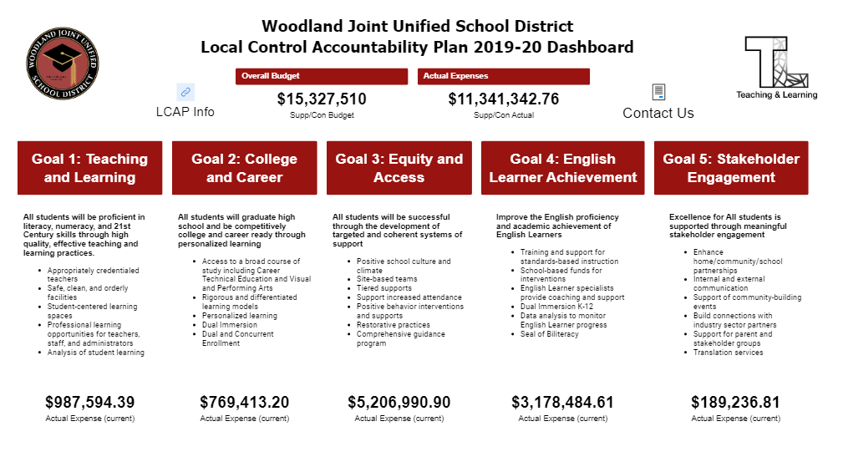
LCAP Monitoring

Slide 15
Stakeholder Input Plan
Stakeholder Group | Type of Meeting | Timeline
Students | Focus Groups | November - December
Teachers | School Site Staff Meetings | October - December
Classified Staff | CSEA Chapter Meeting | December
Parents and Community | Town Hall Meetings | October and Jan/Feb
Administrators | Leadership Academy | February
LCAP Collaborative | Scheduled Meetings | Ongoing
District English Learner Advisory Committee | Scheduled Meetings | Ongoing
Other Committees: African American Parent Advisory Committee CTE Advisory Committee Special Education Parent Advisory Committee School Climate Committee Ethnic Studies Advisory Committee |  | October - December

Slide 16

Schedule of LCAP Meetings
Monday, September 23
Monday, October 28
Monday, December 9
Monday, January 27
Monday, March 23
Monday, April 20
Tuesday, May 12
All meetings 6 -7:30 pm at WJUSD District Office

Slide 17
Questions?

